Slide 1



Slide 2
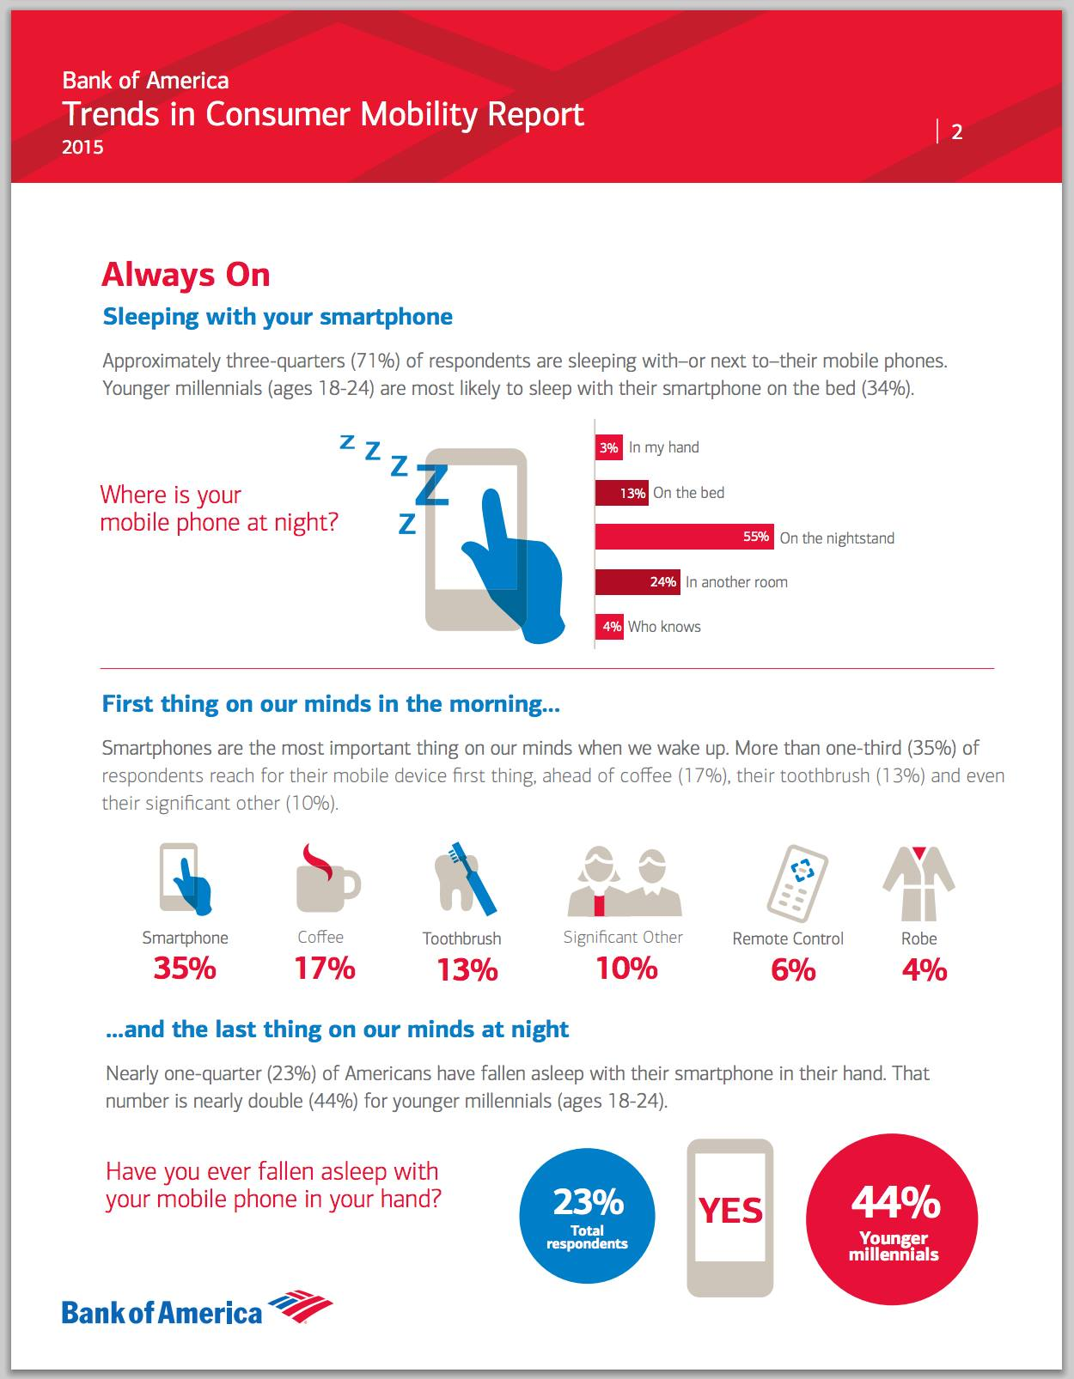

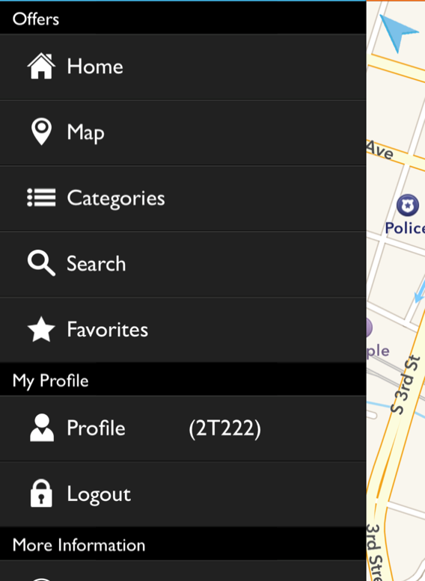
24/7
The most valuable marketing real-estate is the mobile device screen. If you can get a customer’s permission to message their mobile, you have direct access to them 24/7!” –Matt Frazier, CEO, Beakn Mobile

Slide 3

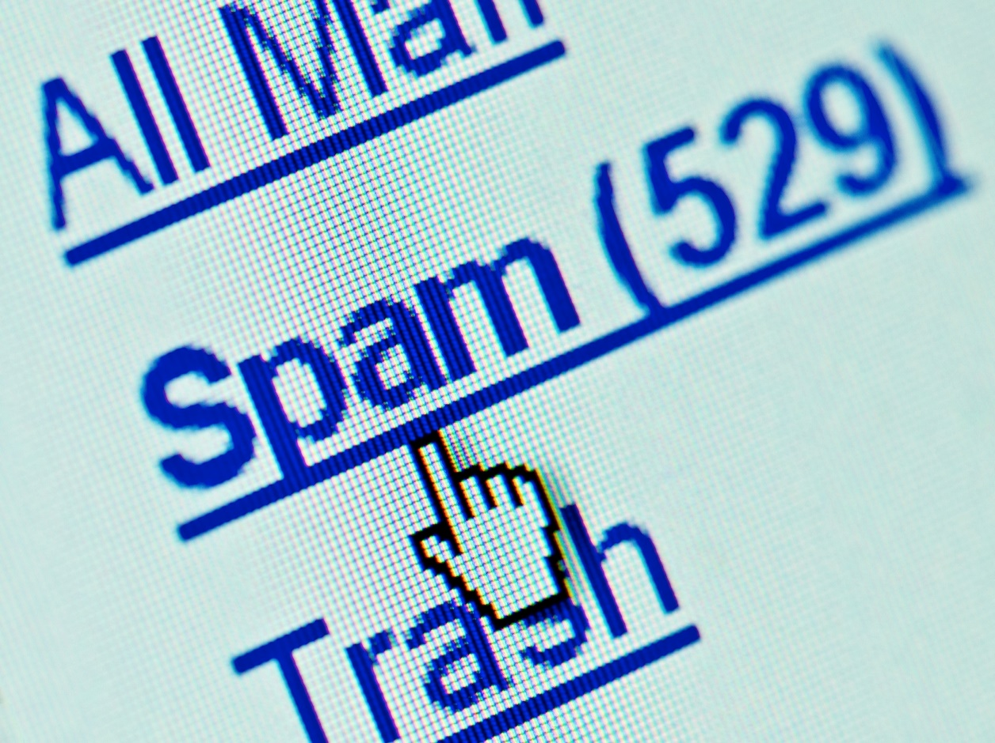
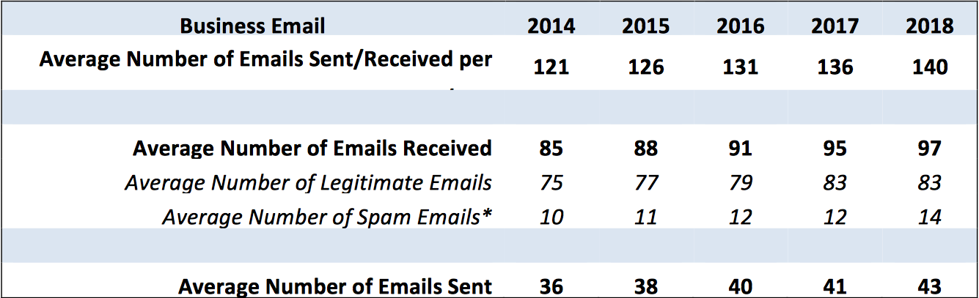
Email effectiveness is rapidly declining
The average number of business emails received per day is increasing. By 2018, the average will be 140 email messages per day.

Slide 4
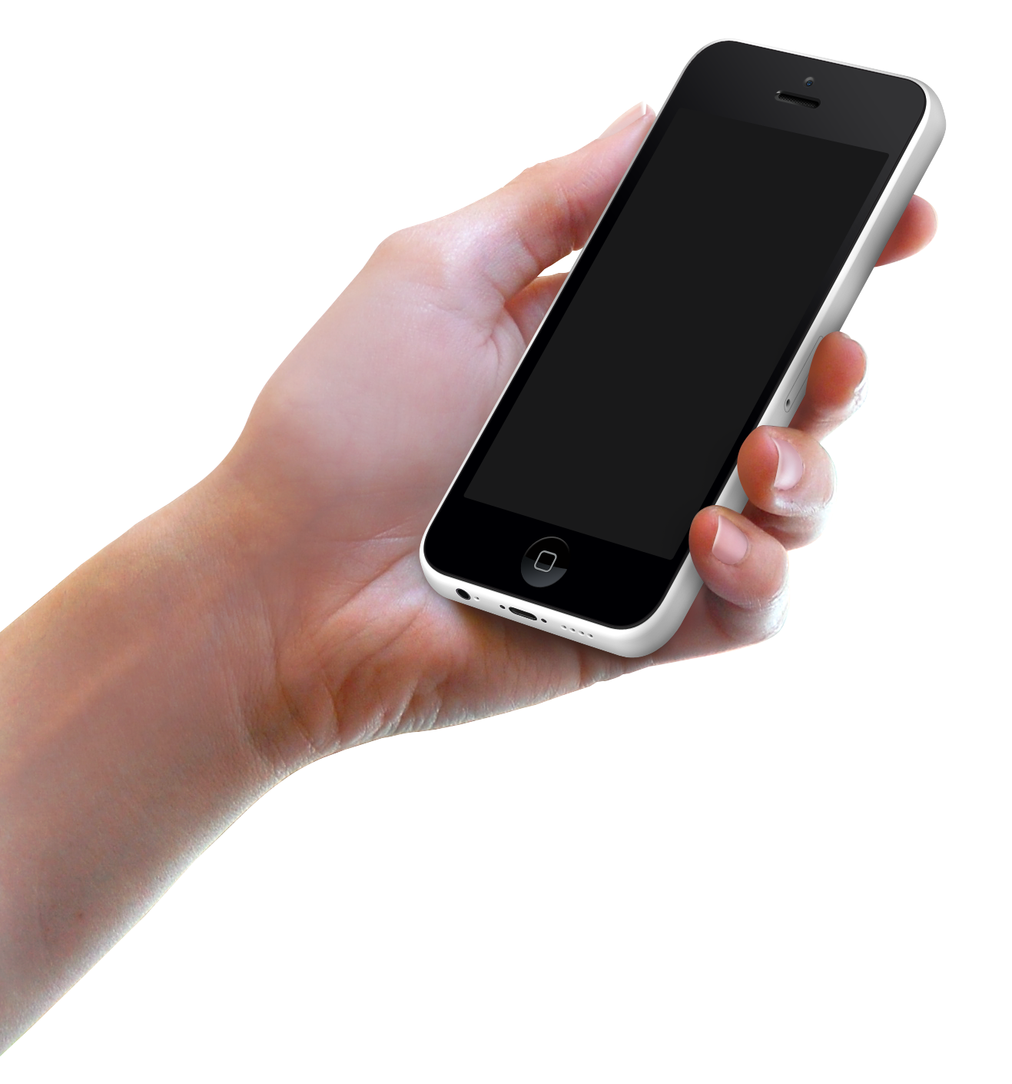


How do you cut through the noise?
Gain DIRECT access to their device!

Slide 5

#1 Way to Increase Profits
Building loyalty with 5% more customers would lead to an increased average profit per customer of between 25%
and 100% - The Loyalty Effect
The probability of selling to an existing customer is 60 – 70%. The probability of selling to a new prospect is 5-20% – Marketing Metrics.

Slide 6

Consumers want mobile rewards and discounts!
“Consumers want the convenience and simplicity of mobile: 45% want real-time mobile promotions and 39% want mobile loyalty solutions.”
https://www.accenture.com/us-en/insight-driving-value-adoption-mobile-payments-consumers-want-more-summary.aspx

Slide 7
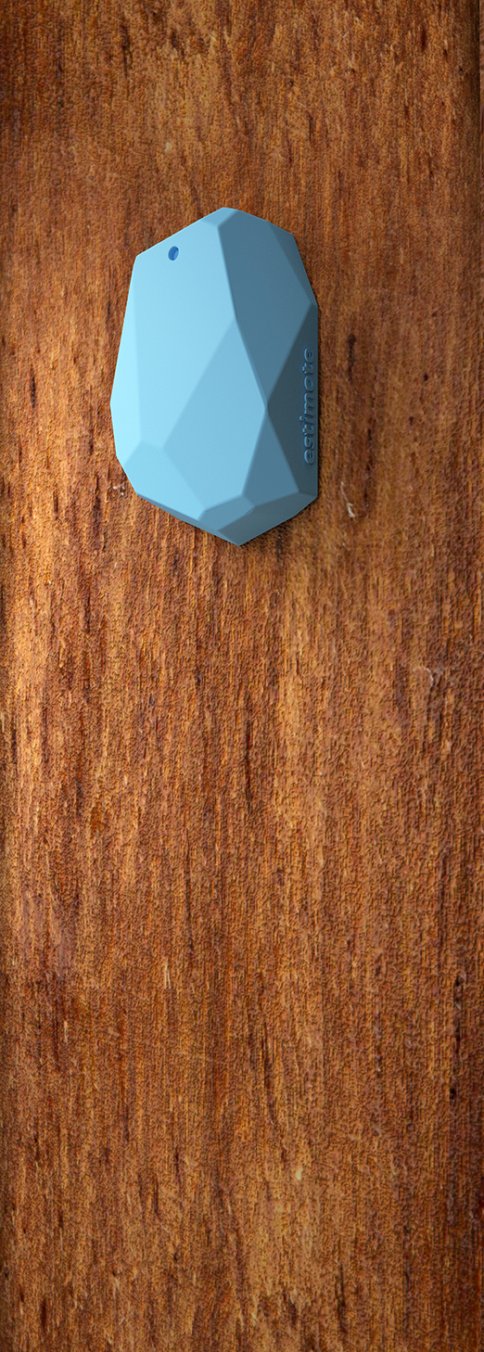
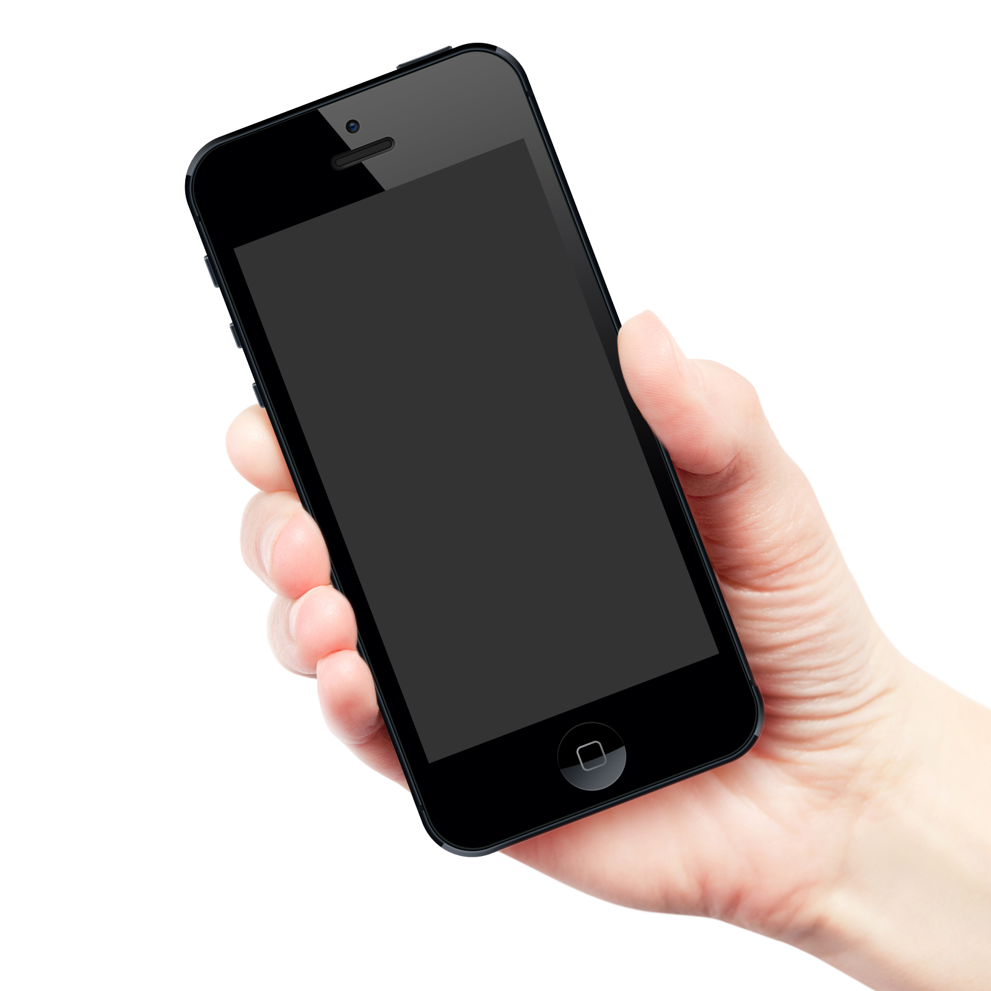


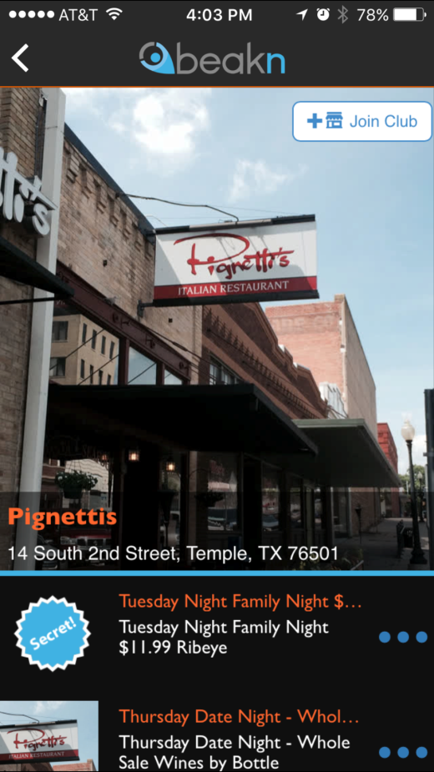

Grow your business with...
Beakn is a mobile, automated customer loyalty program for your local business.
MOBILE – Connect directly with a user’s device!
AUTOMATED – Automatically engages consumers!
LOYALTY – Build more profitable relationships!
LOCAL – Priced affordably for any local business!
7

Slide 8

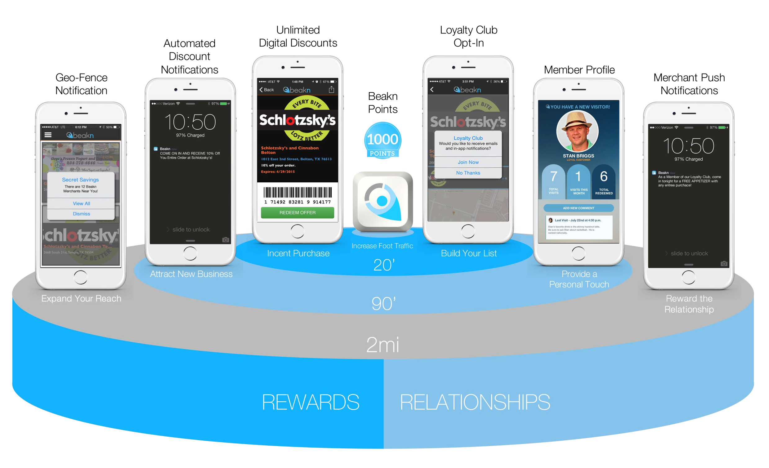
How it works...
8

Slide 9
Increase your Revenue with Beakn!
What to expect from a successful loyalty program...
If only 10% join your loyalty club...
FOOT TRAFFIC 1000 VISITORS PER/MO
NEW LOYALTY MEMBERS 100 PER/MO
AVERAGE SPEND $28 PER VISIT
LOYALTY EFFECT INCREASE $7-$28 (25-100%)
$8K-$34K/YR

Slide 10
Beakn Loyalty Pricing
Set-Up Fee
2016 Pricing
149
100
$
$
One-time
per month
Custom Set-Up
Unlimited Offers
Staff Training
2-Mile Geofence
Local Contact
One Hardware Beacon
Telephone Support
10 Table Tents
POS Promo Cards

Slide 11
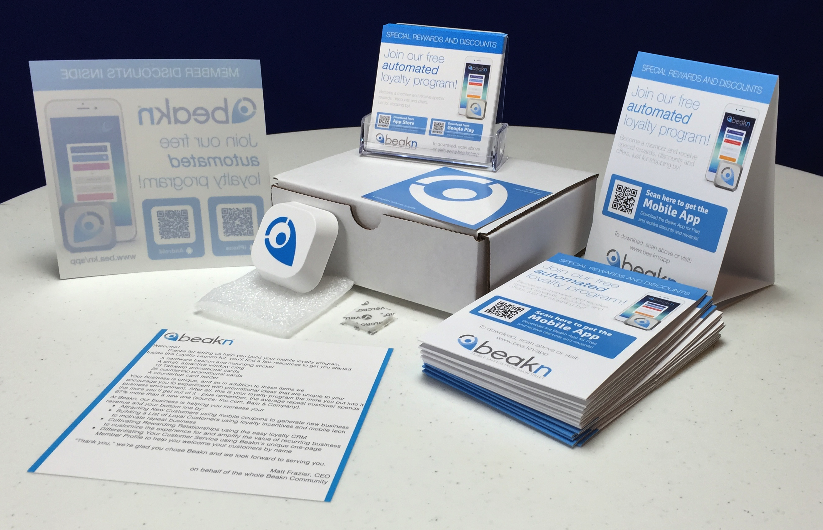
Beakn Merchant Kit
Everything to get you started!
1
Hardware Beacon
1
Window Cling
10
Table Tents
25
POS Cards

